Slide 1
Class Diagram
Software Design and Architecture

Slide 2
Outline
Class Diagram:
  Classes
    Representation
  Relationships
    Associations
    Inheritance relationships
    Aggregation & Composition
    Dependency

Slide 3
What are classes
An object is any person, place, thing, concept, event, screen, or report applicable to your system.
Objects both know things (they have attributes) and they do things (they have methods).
A class is a representation of an object and, in many ways, it is simply a template from which objects are created.
  Although thousands of students attend the university, you would only model one class, called Student, which would represent the entire collection of students.

Slide 4
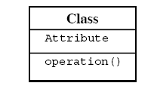
Class representation
Classes are typically modelled as rectangles with three sections
  the top section for the name of the class,
  the middle section for the attributes of the class, and
  the bottom section for the methods of the class.

Slide 5
Attributes are the information stored about an object
  For example, students have student numbers, names, addresses, and phone numbers.
Methods are the things an object or class does.
  Students also enrol in courses, drop courses, and request transcripts.

Slide 6
Relationships
There are four types of relationships that you can set up between classes:
  Associations
  Aggregations & Composition
  Generalizations
  Dependencies

Slide 7
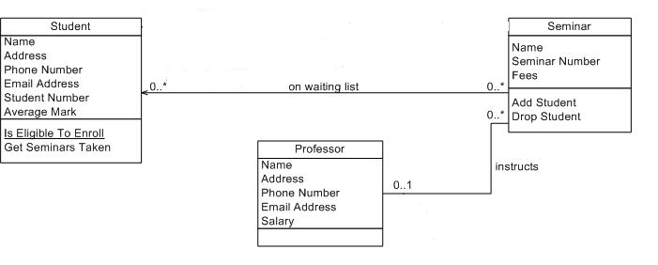
What are Associations
Objects are often associated with, or related to, other objects.
  For example, in a Student Registration System several associations might exist:
  Students are ON WAITING LIST for seminars, professors INSTRUCT seminars, seminars are an OFFERING OF courses.

Slide 8
Associations are modelled as lines connecting the two classes whose instances (objects) are involved in the relationship.
When you model associations in UML class diagrams, you show them as a thin line connecting two classes

Slide 9
Multiplicity of Associations
It is not enough simply to know professors instruct seminars.
  How many seminars do professors instruct? None, one, or several?
  Furthermore, associations are often two-way streets: not only do professors instruct seminars, but also seminars are instructed by professors.
  This leads to questions like: how many professors can instruct any given seminar?
The implication is you also need to identify the multiplicity of an association. The multiplicity of the association is labelled on either end of the line, one multiplicity indicator for each direction

Slide 10
Representing Associations & Multiplicity

Slide 11
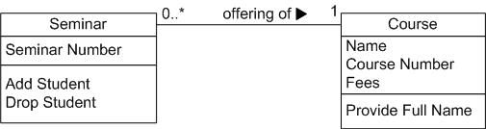
“Seminar is an offering of the Course”

Slide 12
Relationships
  Associations
  Aggregations & Composition
  Generalizations
  Dependencies

Slide 13
Compositions
Sometimes an object is made up of other objects.
  For example, circle is made up of points,
  A building is composed of one or more rooms.
"has a" relationship.
Example: A company is composed of departments.

Slide 14

An Example of Composition Relationship
In UML , composition would be shown with a filled diamond.
In composition the child class's instance lifecycle is dependent on the parent class's instance lifecycle.

Slide 15
Aggregations
An aggregation relationship indicates that one class is a part of another class.
In an aggregation relationship, the child class instance can outlive(carry on) its parent class.
To represent an aggregation relationship, you draw a solid line from the parent class to the part class, and draw an unfilled diamond shape on the parent class's association end.

Slide 16

An Example of Aggregation Relationship
For example, a university owns various departments (e.g., chemistry), and each department has a number of professors.
  If the university closes, the departments will no longer exist,
  but the professors in those departments will continue to exist.

Slide 17
Relationships
  Associations
  Aggregations & Composition
  Generalizations
  Dependencies

Slide 18
Generalization Relationship
Generalizations are used to show an inheritance relationship between two classes
Inheritance allows one class to inherit all attributes, operations and relationships of another class.

Slide 19
Inheritance models “is a” and “is like” relationships, enabling you to reuse existing data and code easily.
When A inherits from B, we say A is the subclass of B and B is the super class of A.
The UML modelling notation for inheritance is a line with a closed arrowhead pointing from the subclass to the super class.

Slide 20
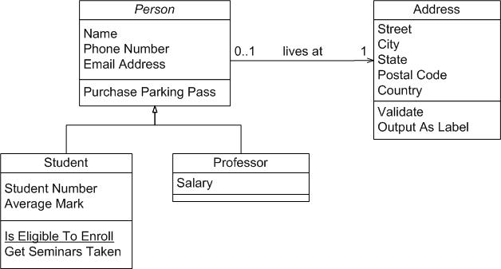
Inheritance - Example

Slide 21
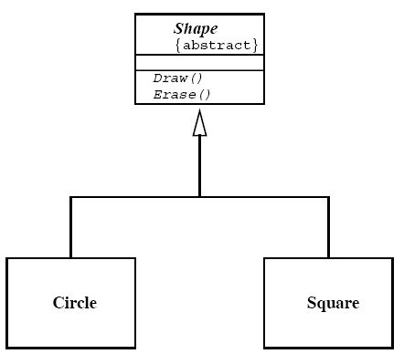
Abstract Class
Abstract classes are not instantiated. They are used in inheritance structures.
They hold some attributes and behaviour common to other classes. It just holds the commonality of the sub classes
In UML, the abstract class is shown in the Class Diagram with its name in italics.

Slide 22
Relationships
  Associations
  Aggregations & Composition
  Generalizations
  Dependencies

Slide 23
Dependency Relationship
Slightly different than Associations
Connect two classes, Shows that one class depends on the definitions in other class, it uses it at some point of time
Dependencies shown with a dashed arrowed line.

Slide 24

Dependency Relationship
So, how does Person Object interact with House Object?
3 approaches:
  “House” could be global
  “House” could be instantiated as a local variable inside an operation of “Person”
  “House” can be passed as a Parameter to some operation inside “Person”.

Slide 25
Difference between Association and Dependency
In dependency one class depends on another if the latter is a parameter variable or local variable of a method of the former.
In an association an attribute of the former class is an instance of the latter class.

